Slide 1
diving into short term real estate
watershed property management

Slide 2


life takes you to unexpected places,
love brings you home
-ANONYMOUS

Slide 3
SOME STATISTICS
In the vacation rentals segment, the number of users is expected to amount to 57.0M by 2023. (statista.com)
User penetration is 9.7% in 2019 and is expected to hit 11.4% by 2023. (statista.com)
Revenue in the vacation rentals segment amounts to $17,507M in 2019. (statista.com)
Revenue is expected to show an annual growth rate (CAGR 2018-2023) of 7.2%, resulting in a market volume of $18,517M by 2023. (statista.com)
According to a Hawaii Tourism Authority report, 15% of visitors would not have gone to Hawaii if there hadn’t been the option to stay in alternative accommodations, such as vacation rentals. (Evolve Vacation Rental Network)

Slide 4
background of analysis and assumptions
Transaction fee 30%
Average length of stay 3 days
Depreciation 5 years
Cut off long term profitability 6000$
yearly cost of utilities 3600$
cost of yearly repairs 6000$
conversion costs 30,000 $
variable cost per customer 100$

Slide 5
an overview of my suggestion

Slide 6
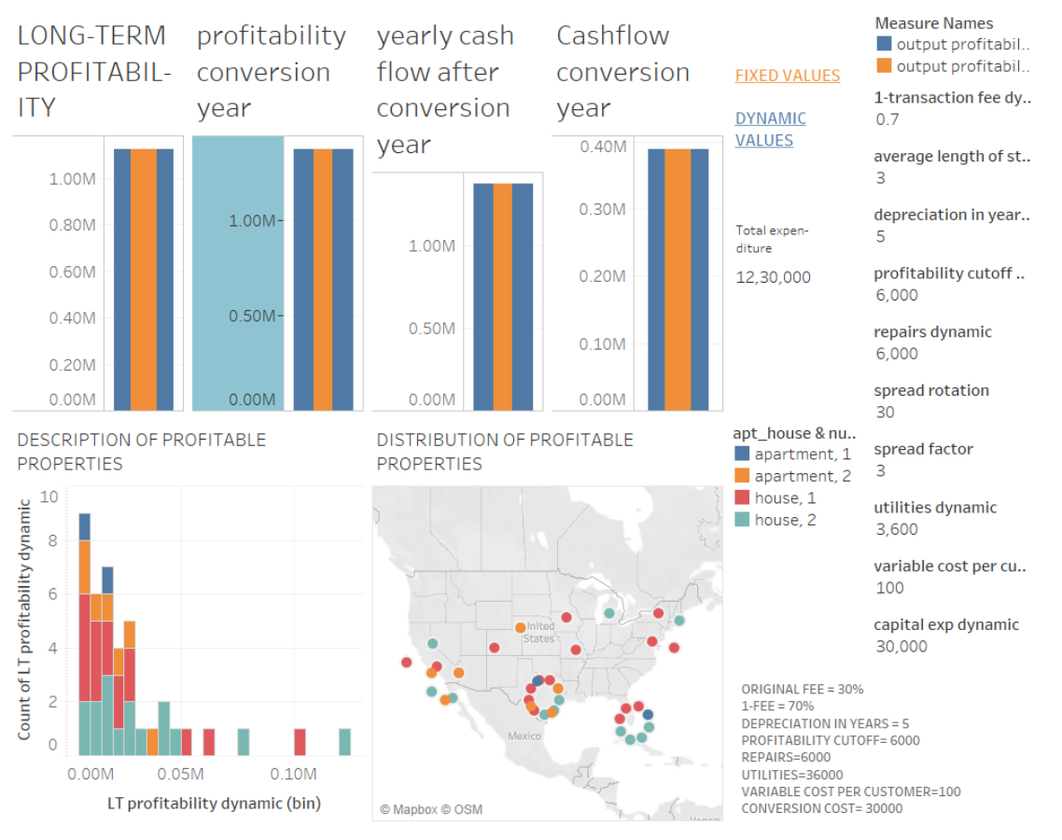

Slide 7
expected profits in first year 1.37 M
expected profits long term 1.31 M
capital investment $1230000
cash flow conversion year 1.37M
cashflow each year after 0.34M

Slide 8
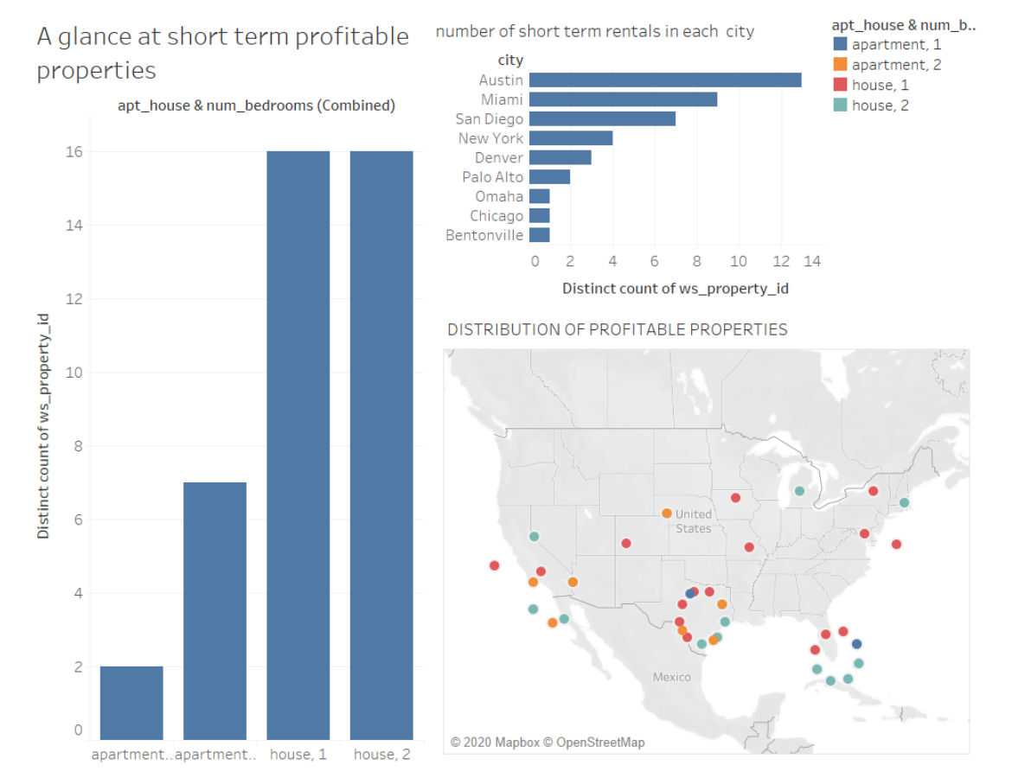

Slide 9
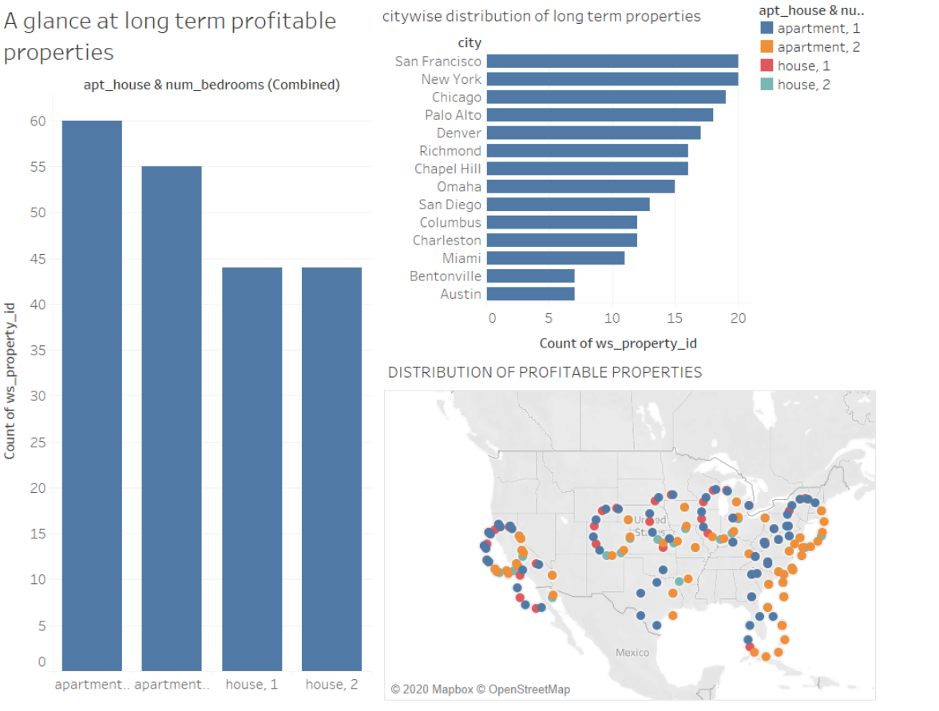

Slide 10
what next?
implement the short term conversion in 3 stages over 3 years.
year 1 has 10 conversions, year 2 has 15 and the remaining 16 in year 3
feedback from each year can help alter assumptions and better plan the next stages

Slide 11
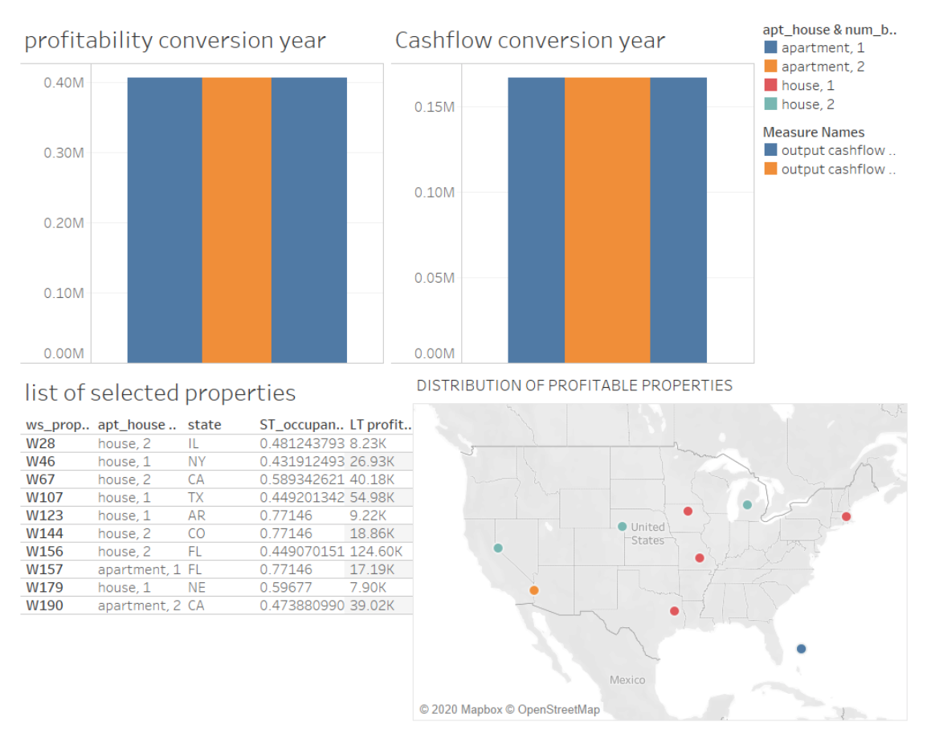
properties chosen for phase 1

Slide 12
 | best case scenario | worst case scenario
cost of conversion | 24000 | 36000
depreciation in years | 7 | 3
yearly upkeep | 5000 | 7000
service fee | 14% | 16%
regulatory fee | 10% | 18%
hospitality charges | 80 | 120
duration of stay | 7 | 1
monthly utilities | 250 | 350
profit | 2.67 M | 0.29M
initial expenditure | 1230000 | 1230000

Slide 13
Thank you

